Slide 1

Sentiment Analysis on Yelp Review Dataset
By Shreyas Shivakumar Kasetty
UIN: 534002320
Course:
CSCE 633 (Machine Learning)

Slide 2
INTRODUCTION
Evolution of Sentiment Analysis:
Sentiment analysis has undergone a remarkable evolution, advancing from basic text classification to sophisticated deep learning methodologies.
This growth is propelled by the surge of social media, where users continuously generate vast amounts of opinion-rich text.
Impact of Social Media Data:
Social media platforms, have become goldmines for opinionated data, offering real-time insights into public sentiment.
The analysis of such data is vital, as it sheds light on customer preferences and experiences, shaping business strategies and decision-making.
Importance in Business and Analytics:
For businesses, especially in the hospitality and service sectors, understanding customer feedback on platforms like Yelp is key to adapting and thriving.
Sentiment analysis helps translate unstructured feedback into actionable insights, driving customer engagement and satisfaction.

Slide 3
Project Objectives
Building a Transformer Model for Sentiment Analysis:
Develop a transformer model tailored for analyzing sentiments in Yelp restaurant reviews.
Utilize NLP techniques to process and interpret complex textual data efficiently.
Utilize hyperparameter tuning techniques to optimize the model to better accuracy results.
Achieving Comprehensive Sentiment Analysis:
Aim to accurately classify a wide range of sentiments in Yelp reviews, from positive and negative to neutral.
Ensure the model can understand and interpret various linguistic nuances, context, and subtleties present in customer feedback.

Slide 4
Methodology
Dataset Preprocessing:
Text Normalization: Converting all text to a standard format, typically lower case, to ensure consistency
Stop Words Removal: Eliminating common words that provide little value in understanding the sentiment of the text.
Punctuation Removal: Stripping punctuation marks, which are generally not informative for sentiment analysis models.
Data Augmentation: Applying techniques such as back-translation to enhance the robustness of the dataset by artificially increasing its size and variety.
Tokenization: Splitting text into individual words or tokens to facilitate further processing.
Hyper Parameter Tuning:
Grid Search: Different combinations of hyperparameter values were used to search for the best combination.

Slide 5
Transfer Learning with RoBERTa
Understanding Transfer Learning:
Transfer learning involves taking a model that's been trained on a large dataset and adapting it to a specific task.
It's like giving a head start to the model, so it doesn't learn from scratch.
RoBERTa as a Pretrained Model:
RoBERTa is a robustly optimized version of BERT, pre-trained on an extensive corpus of text.
It's designed to understand the context and nuances of language
Benefits of Using RoBERTa:
Leveraging RoBERTa saves significant computational resources and time.
It provides a deep understanding of language, which is crucial for accurate sentiment analysis.

Slide 6
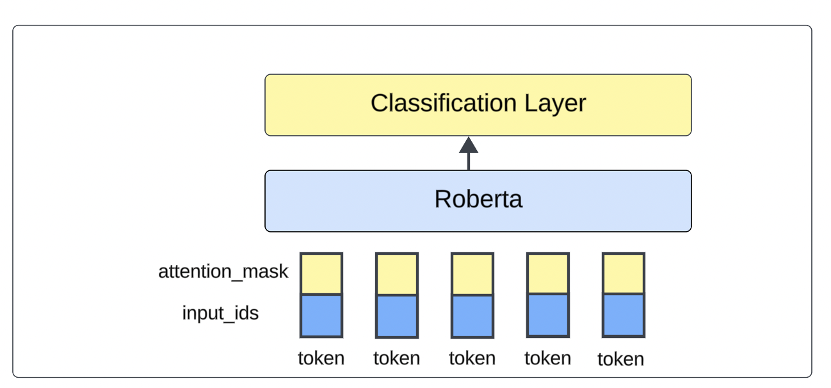
RoBERTA-Simple Architecture

Slide 7
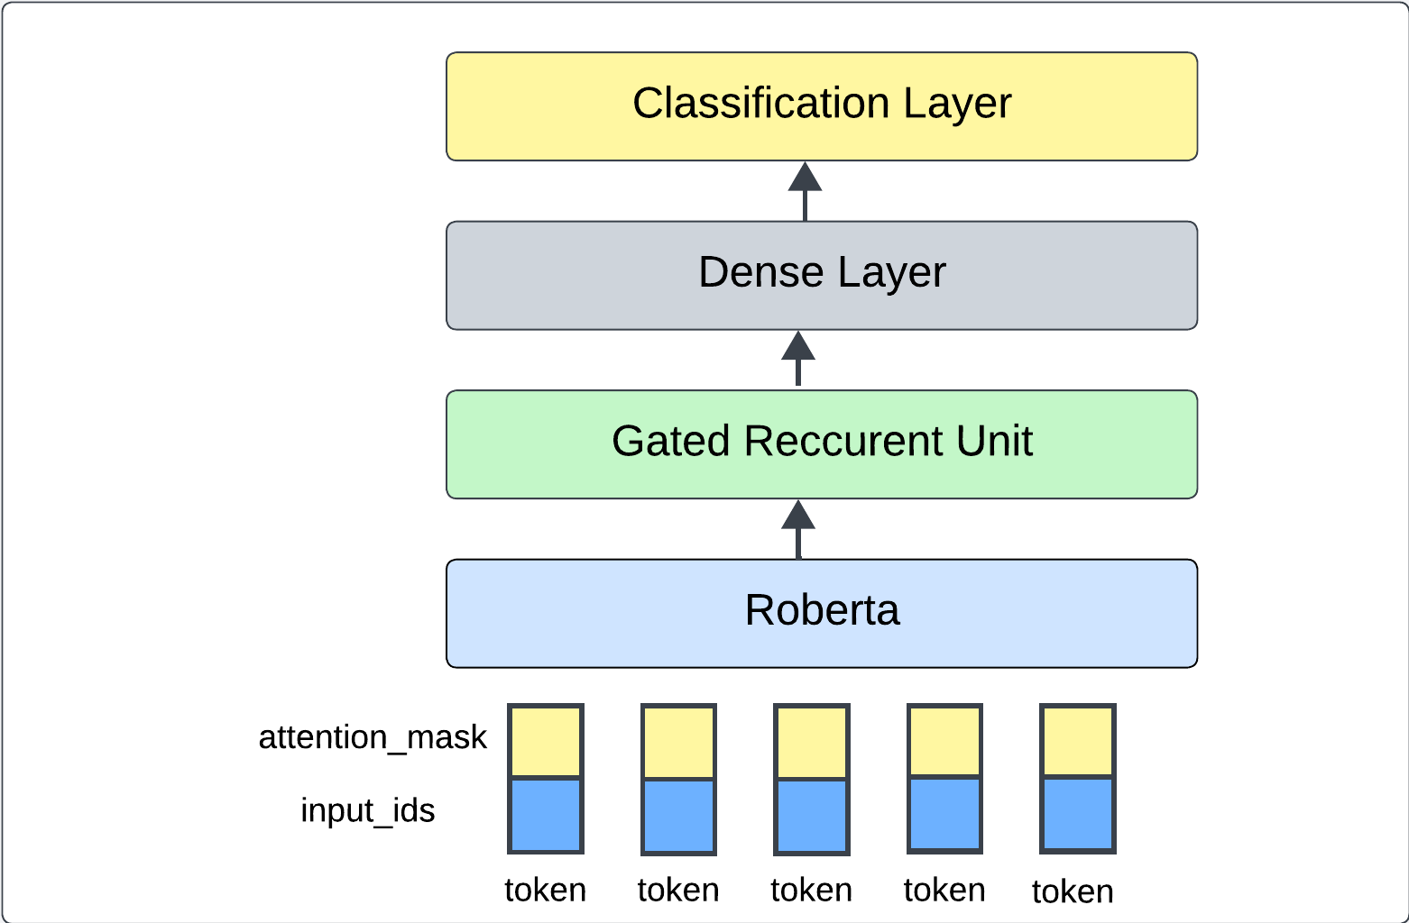
RoBERTA-GRU Architecture

Slide 8
ROBERTa
RoBERTa, a transformer model, excels in understanding language context.
Encodes Yelp reviews by analyzing word context for nuanced sentiment detection.
Trained on vast text data, RoBERTa brings pre-existing knowledge to the task.
Its architecture precisely focuses on important text parts, capturing subtle review aspects.
Enables high-accuracy sentiment classification by understanding complex expressions.

Slide 9
Gated Recurrent Unit
GRU excels in processing word sequences in Yelp reviews.
Capable of retaining crucial information across long text passages.
GRU ensures that both initial praise and final criticism in reviews are considered for true sentiment reflection.
These gates help the model determine which data to keep and which to discard, avoiding information overload.
The GRU is integral in considering the full context, from a review’s start to finish, for accurate sentiment analysis.

Slide 10
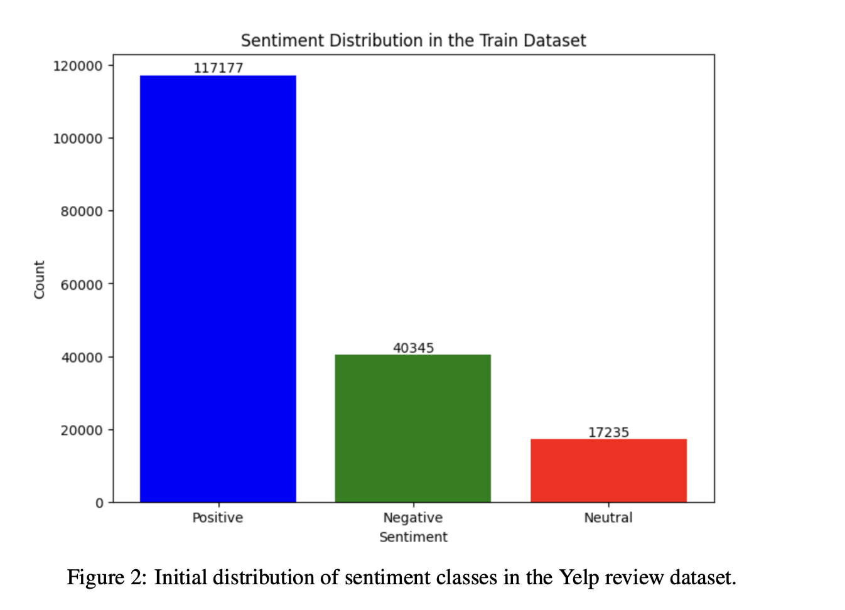
Train DATASET

Slide 11
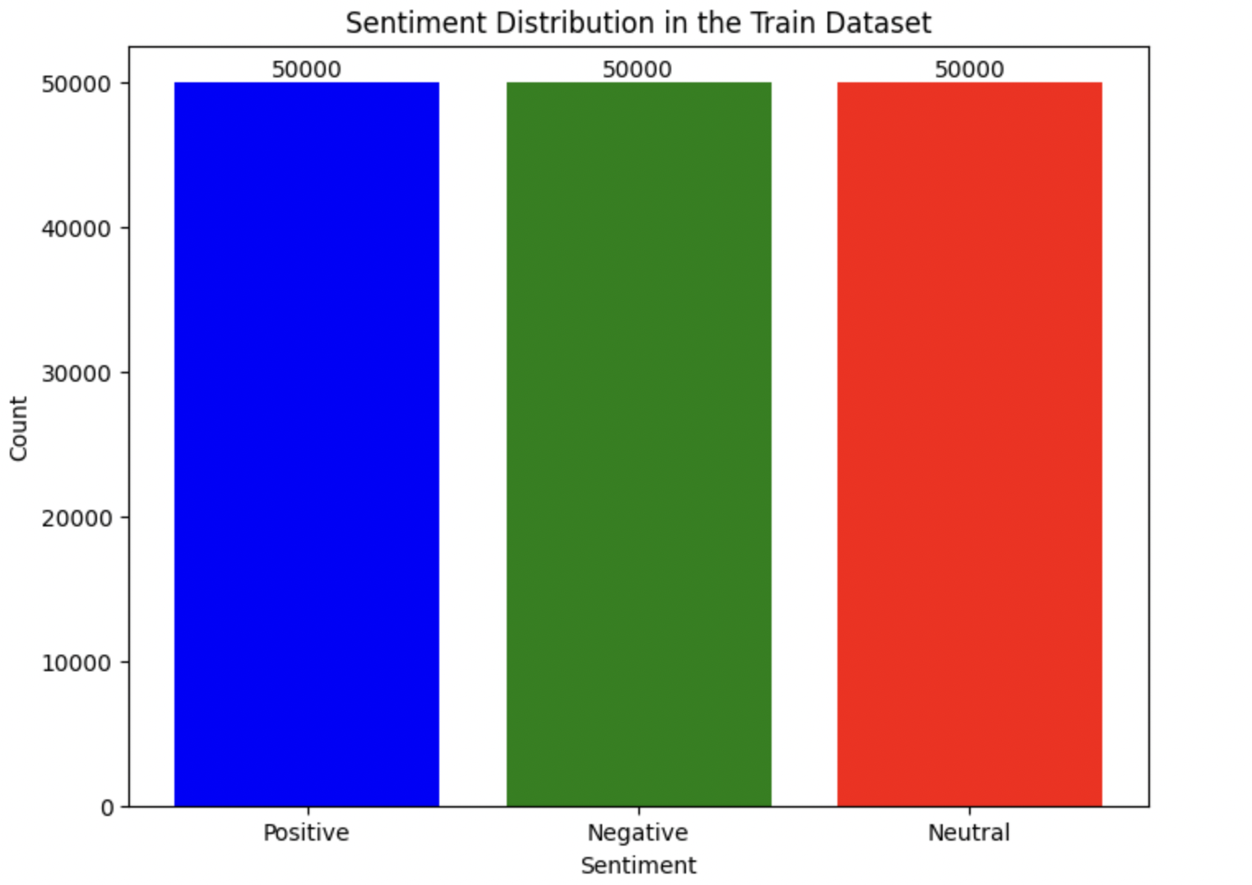
DataSET Balancing

Slide 12
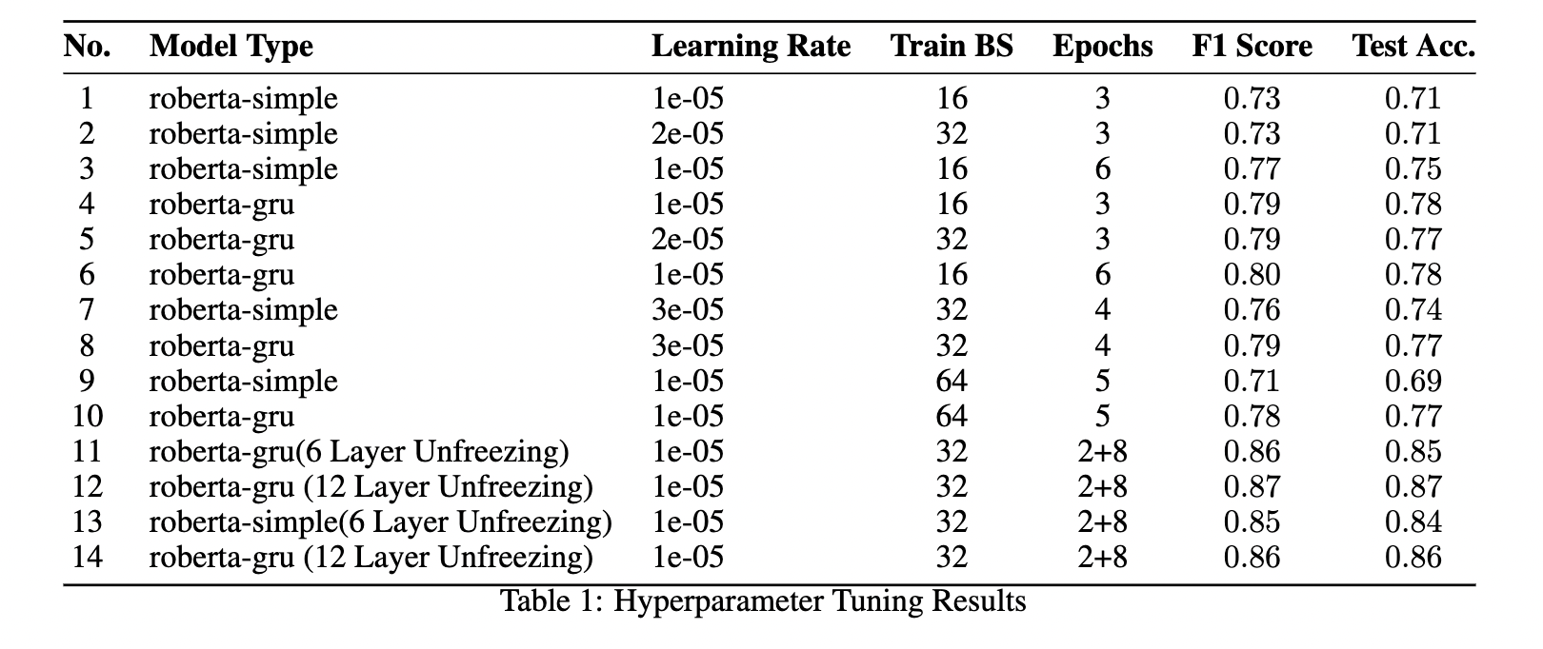
Hyper-Parameter Tuning

Slide 13
Selected HYPERPARAMETER VALUES
• Model Type: roberta-gru • Learning Rate: 1e − 05 • Training Batch Size: 32 • Epochs: 10 (interpreted as 2 + 8 from the provided configurations) • Unfreeze Layers: 12

Slide 14
Experiment 1 and Result Analysis
With Dataset Augmentation and Balancing In the first experiment, the dataset was balanced by downsampling the positive class to match the average size of 50000. The results were as follows: • F1 Score: 0.885 • Test Accuracy: 0.88 • AUC Scores: Negative - 0.985, Neutral - 0.897, Positive - 0.975 These results indicate a balanced and effective model performance across all classes, underscoring the benefits of dataset augmentation and balancing.

Slide 15
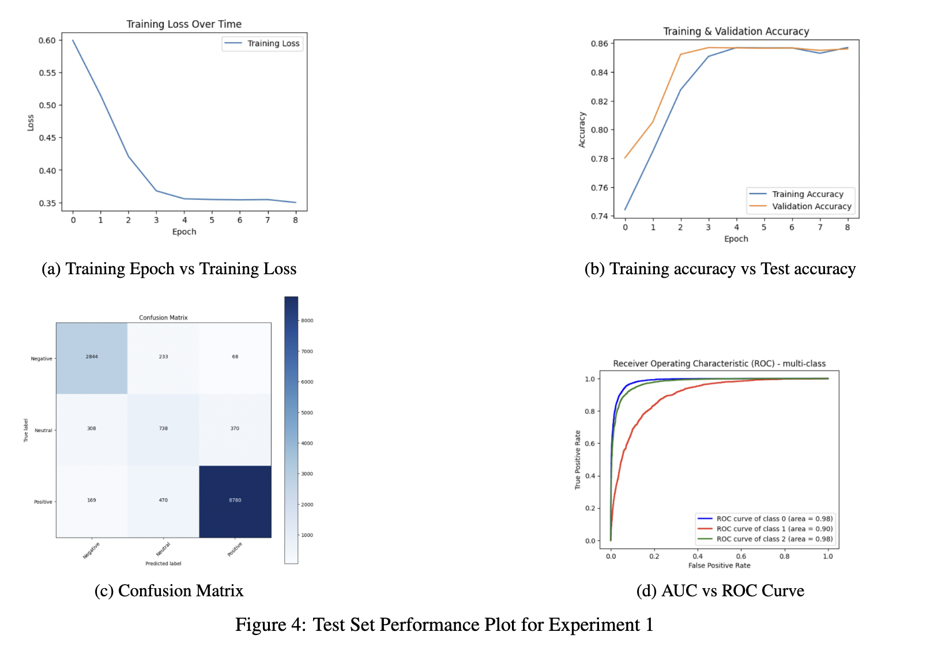

Slide 16
Experiment 2 and Result Analysis
Without Dataset Augmentation and Balancing The second experiment, conducted without dataset augmentation and balancing, yielded these results: • F1 Score: 0.883 • Test Accuracy: 0.89 • AUC Scores: Negative - 0.986, Neutral - 0.902, Positive - 0.977 Despite the absence of data balancing, the model achieved a slightly higher test accuracy. However, the F1 score was marginally lower than in the balanced dataset experiment. A key factor in this performance is the imbalance in the test dataset, which mirrors the training dataset’s skew towards the positive class.

Slide 17
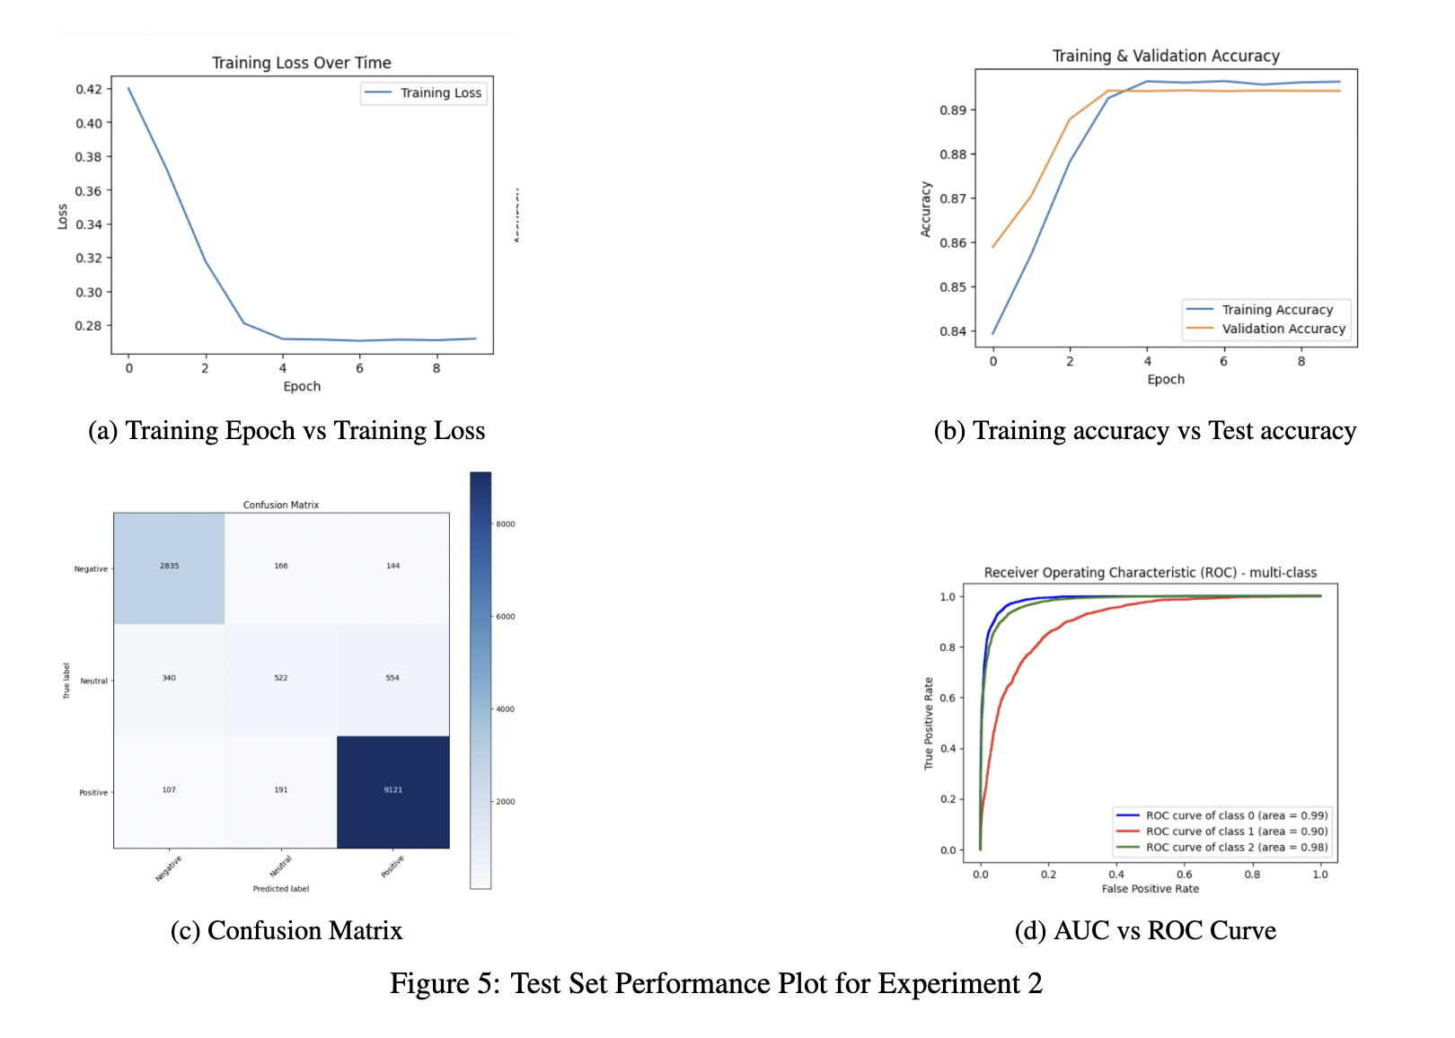

Slide 18
Experiment 3 and Result Analysis
Gradual Unfreezing of Pretrained RoBERTa Layers: Another experiment involved gradually unfreezing the pretrained RoBERTa layers: • F1 Score: 0.827 • Test Accuracy: 0.81 • AUC Scores: Negative - 0.967, Neutral - 0.835, Positive - 0.952 This strategy led to lower performance metrics, suggesting that gradual unfreezing did not favorably impact the model’s accuracy for this specific task.

Slide 19
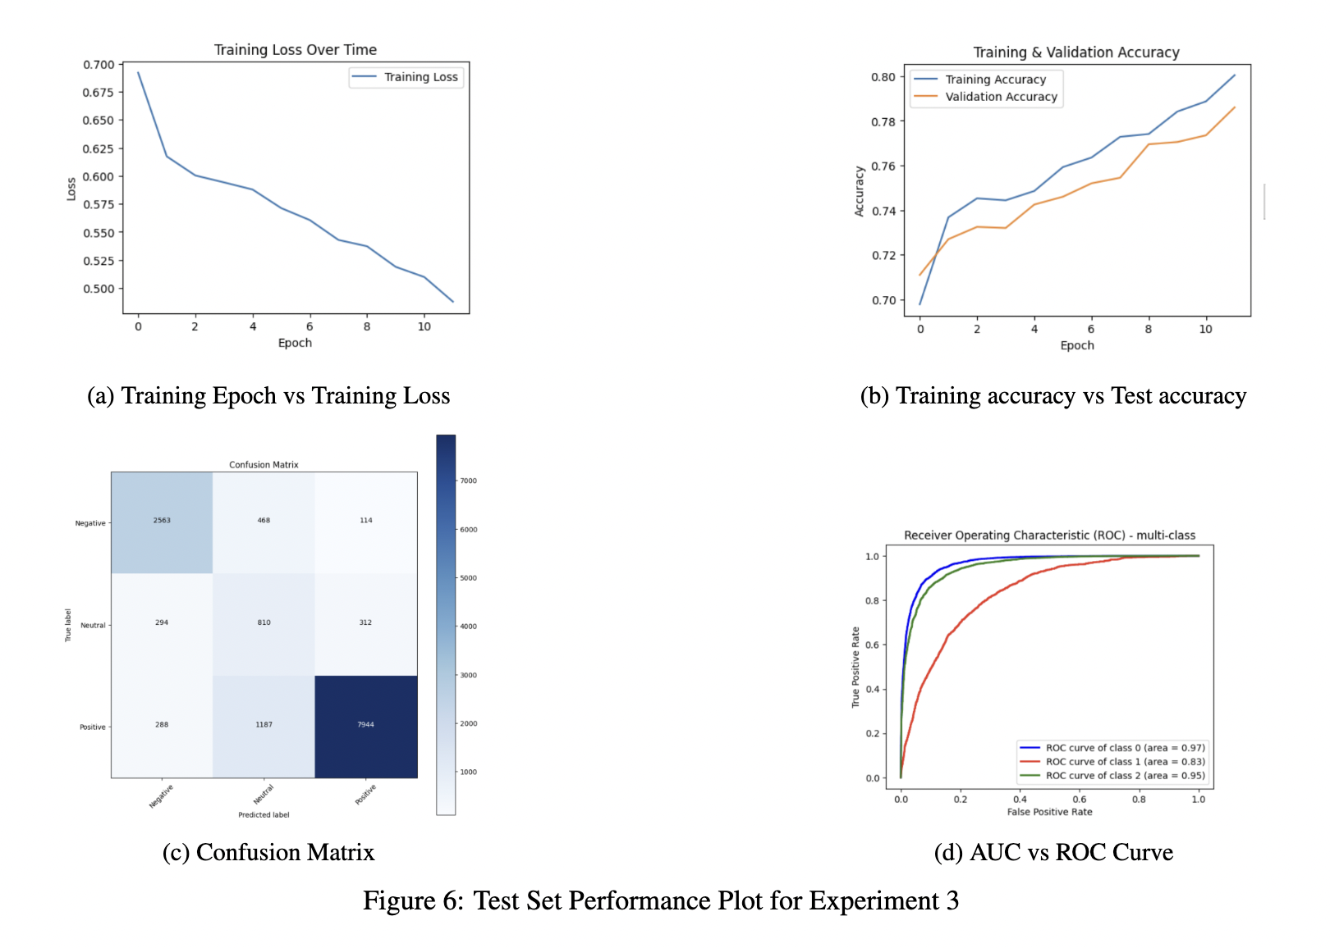

Slide 20
Conclusion
This project successfully demonstrated the efficacy of a RoBERTa-GRU hybrid model in the sentiment analysis of Yelp restaurant reviews. Key takeaways include:
The RoBERTa-GRU integration excelled in understanding contextual nuances and long-range dependencies in text, highlighting its effectiveness for complex NLP tasks.
Data augmentation and balancing significantly improved the model’s F1 score across diverse sentiment classes, emphasizing the importance of dataset composition in training.
Optimal hyperparameters, identified through grid search, enhanced learning efficiency and overall model performance.
A two-phase training strategy provided deeper insights into the adaptability and learning capabilities of the model.

